Slide 1


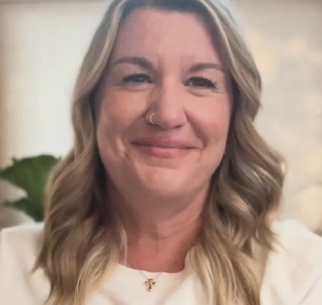

How to Build a Training Program Using the New
featuring…
Jenni Chase
NGA VP, Workforce Development
Elayne Cabrera
NGA LMS Manager for
Workforce Development
Notes:
Good afternoon. On behalf of the National Glass Association, I’m Alicia Mitchual, NGA operations manager, and thank you joining us for today’s webinar, featuring two of my colleagues from the Workforce Development team at NGA – Jenni Chase and Elayne Cabrera. They have been heavily involved in the continual improvements you’ve been seeing across NGA’s education and training platform, and are here today to get into detail on what those upgrades are and how you can implement them.
Jenni, I’ll turn it over to you to get us started!
Jenni: Thank you, Alicia. And thank you everyone for joining us today. I know your time is valuable and I appreciate you sharing it with me. I’m going to be doing a lot of talking, but I do want to answer your questions as well, so please go ahead and put questions in the chat as you think of them, and then at the end of the session, Alicia will open up a Q&A session.
So, the MyGlassClass.com online learning platform has been around for many years and has been used to successfully train thousands of installers and apprentices. That said, we want to make sure that it remains as relevant and useful as possible to the industry, so we have made a few upgrades.

Slide 2
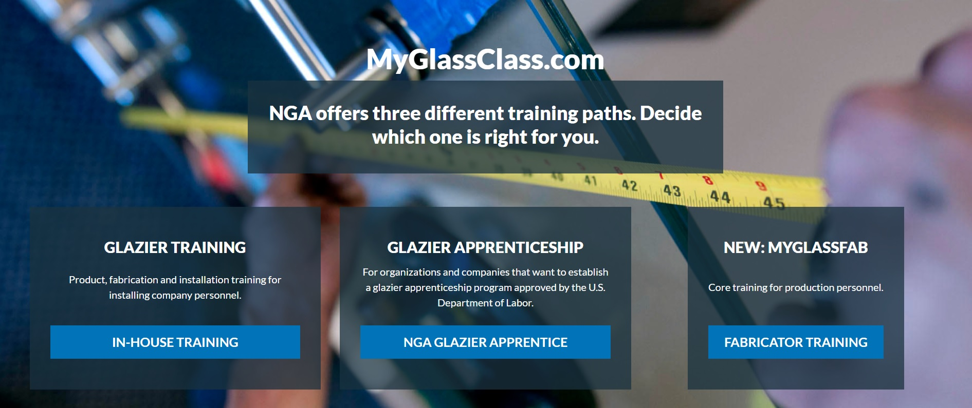
Notes:
The first thing we have done is expand our training content. MyGlassClass also now offers three different training paths: MyGlassClass for installers; the NGA Glazier Apprentice Curriculum for apprentices; and MyGlassFAB for glass fabricator production personnel.

Slide 3

For more information, email apprenticeship@glass.org
Notes:
For this presentation, we are going to focus on company training for installers and production personnel, but if you are interested in glazier apprenticeship, please email us at apprenticeship@glass.org.

Slide 4
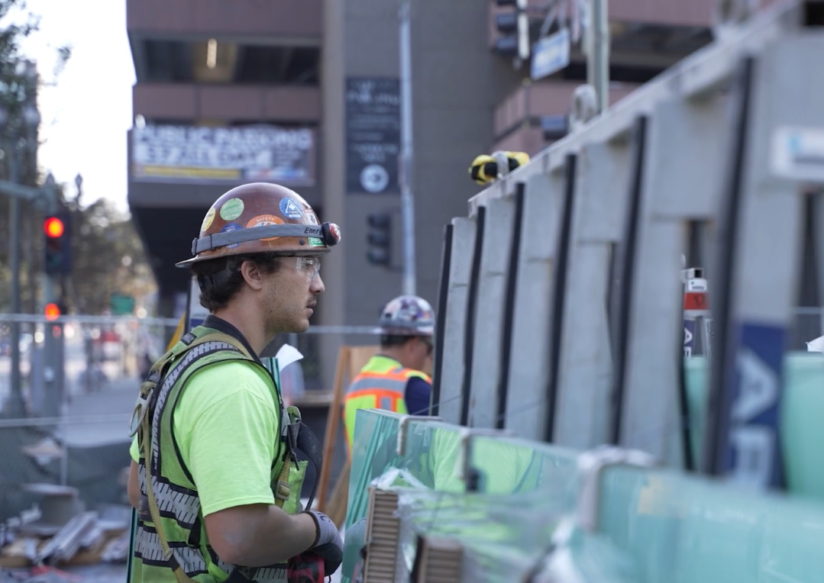
Training for installers
More than 30 courses:
Intro to the Glass & Glazing Trade
Safety
Glass & Metal Fabrication
System Fabrication, Assembly & Installation
Codes, Blueprints & Estimating
Notes:
The MyGlassClass glazier training is for installers. This training is for installers at full-service or contract glazing companies who are new to the glass industry or who are looking to add new skills to their job description. There are more than 30 courses available that cover everything from:
the basics of the glass industry—what does a glazier do, what terminology does the industry use, what is a storefront vs a curtainwall, glazing math, etc.
to safety—how to use PPE, how to handle glass safely, how to move glass, etc.
to glass and metal fabrication—that’s going to cover mirror fabrication and installation, for example. We also now offer a suite of frameless shower enclosure design and installation courses
to system fabrication, assembly and installation—these courses cover how to fabricate storefront metal, how to install storefront correctly, how to build and install curtainwall stick systems
and then we also offer more advanced courses on codes, blueprints, and estimating.

Slide 5

Training on demand
Available on all smartphones
Learn in English or Spanish
Notes:
All of these courses can be taken on a phone, tablet or laptop. And they are all available in English and Spanish.

Slide 6
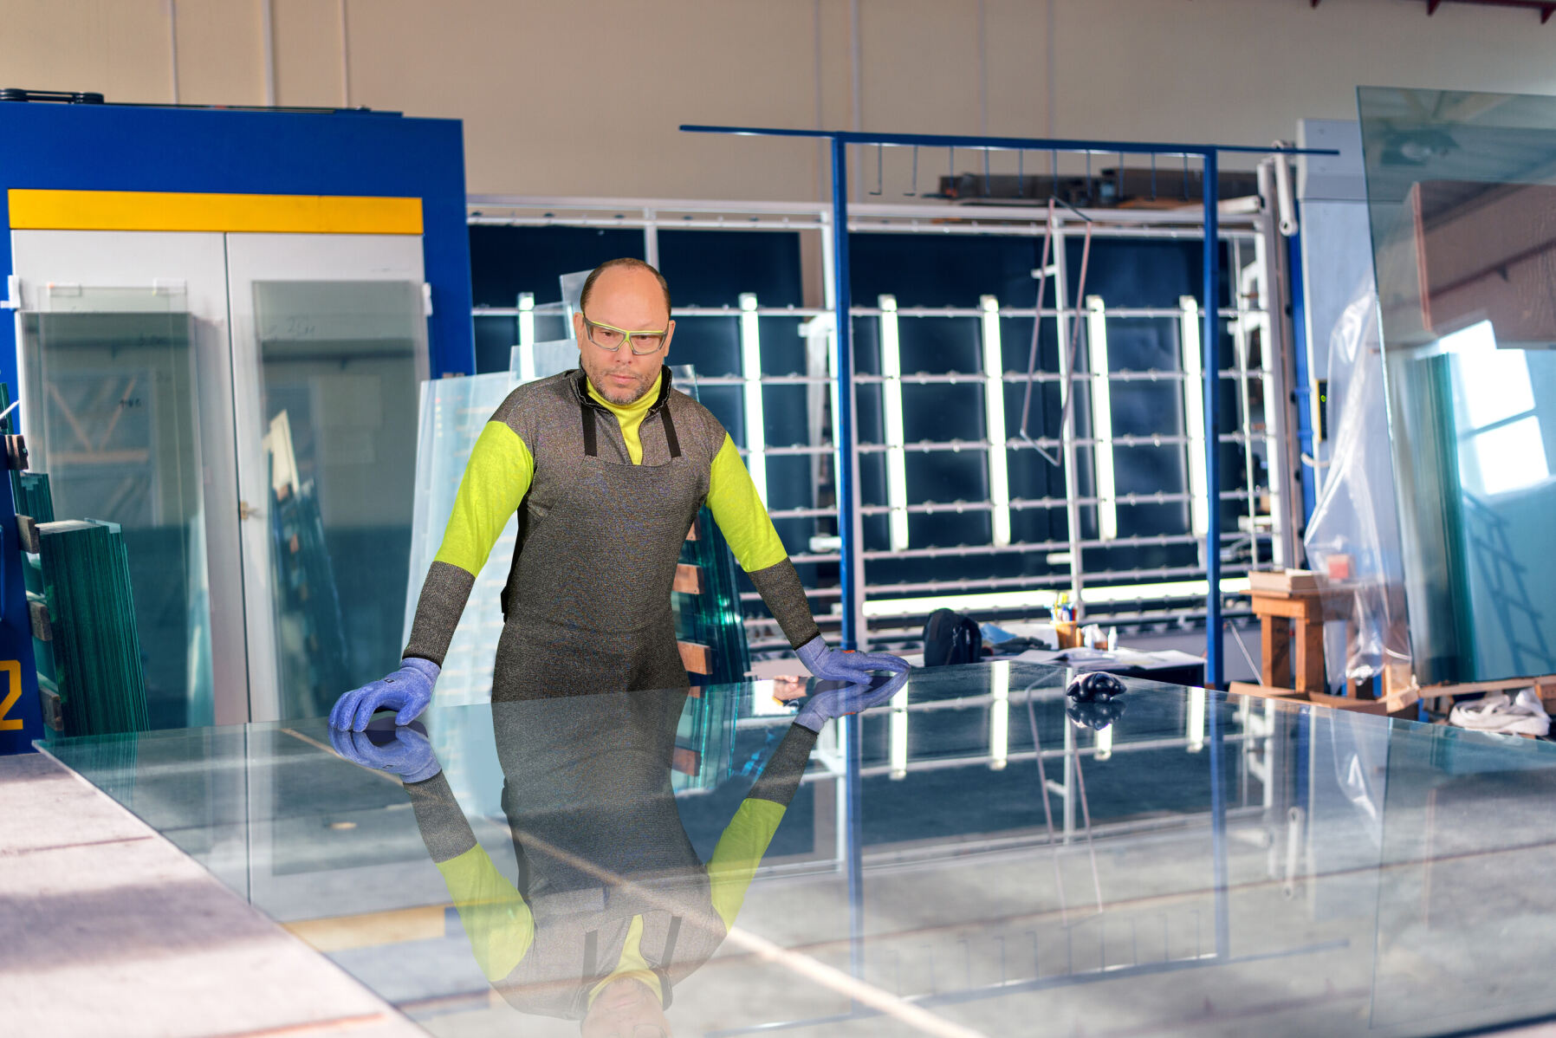
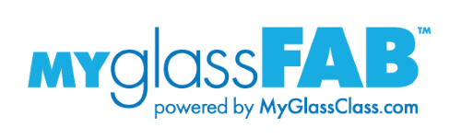
Training for production personnel
18 courses:
Safety
Glass Quality Inspection
How to Measure Glass
Basic Math
Coming Soon: Tempering
Notes:
MyGlassFAB is training for entry-level production personnel. So we’re talking about training for employees who most likely don’t have any specialized skill or prior experience, who are new to the glass industry and who are responsible for tasks like inspecting and measuring glass; loading and unloading glass; rotating glass through the various phases of the tempering, laminating, cutting, or shipping processes; etc.
The interactive courses range in length from five to 15 minutes, with the initial training focusing on safety, glass quality inspection, how to measure glass, and basic math. Courses are available in English and Spanish, and as the course catalog grows, NGA will add training on tempering, laminating, decorative glass, and insulating glass production. Next up for development is a series of courses for tempering furnace operators and quality technicians.

Slide 7
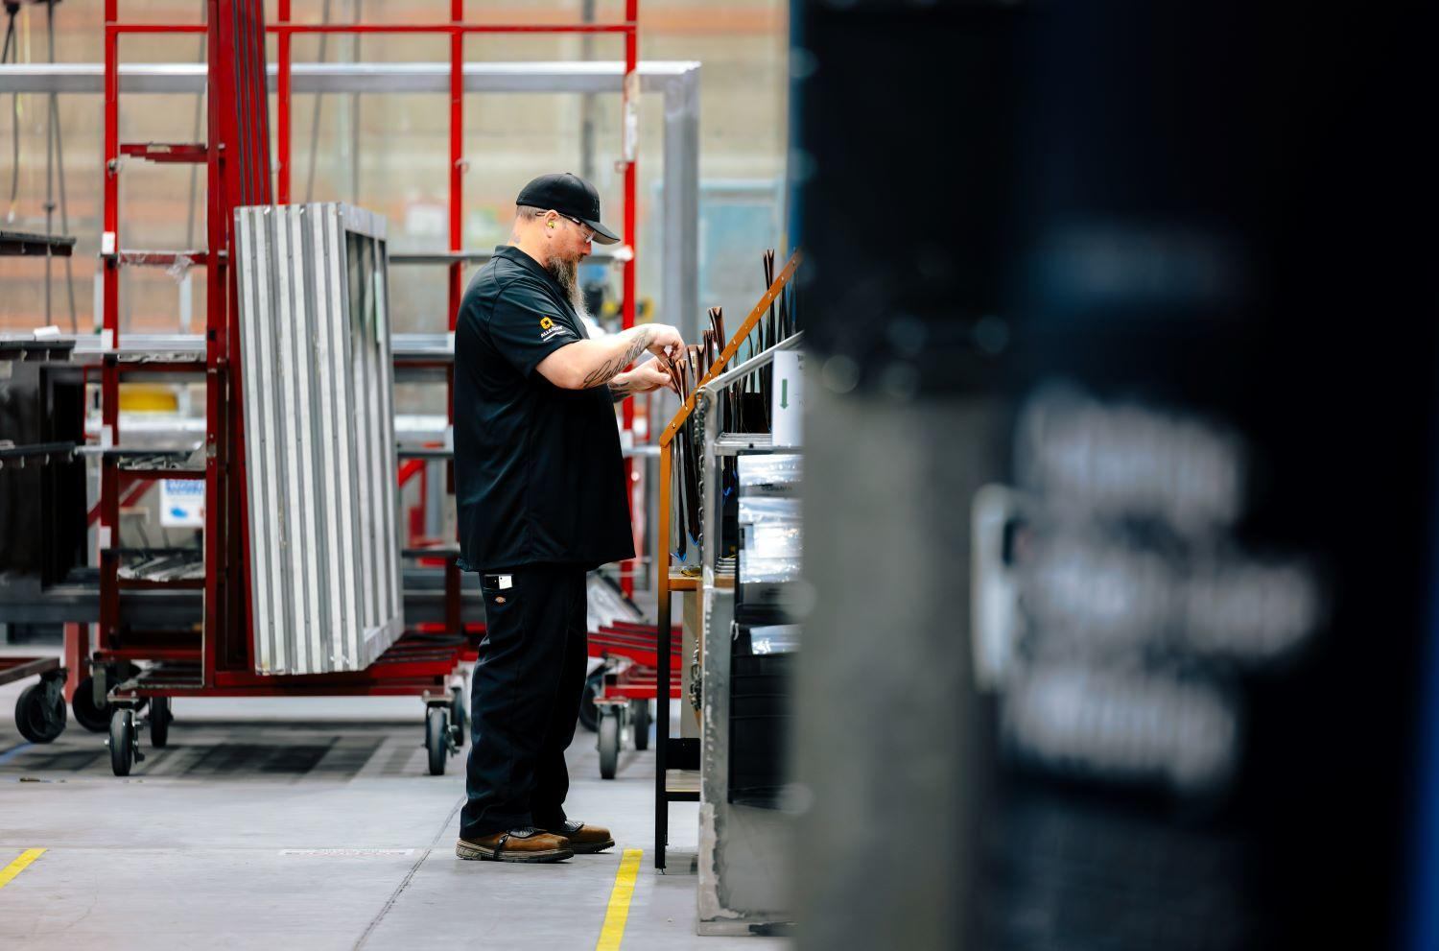
Training on demand
Available on all smartphones
Includes courses, quizzes, and activities
Notes:
Each MyGlassFAB course consists of a 5-10 minute course, a quiz, and a skill activity. Each course has a corresponding quiz that employees need an 80 percent score to pass. Each course also has an optional activity in the form of a downloadable PDF that employees can complete with their supervisor. So, for example, if Bob completes the How to Use a Tape Measure course and passes the quiz, he can then complete the activity showing his supervisor he can correctly use the tape measure. Or, some companies choose to use the activity during the hiring process to screen new hires to make sure they can do the things they say they can.

Slide 8
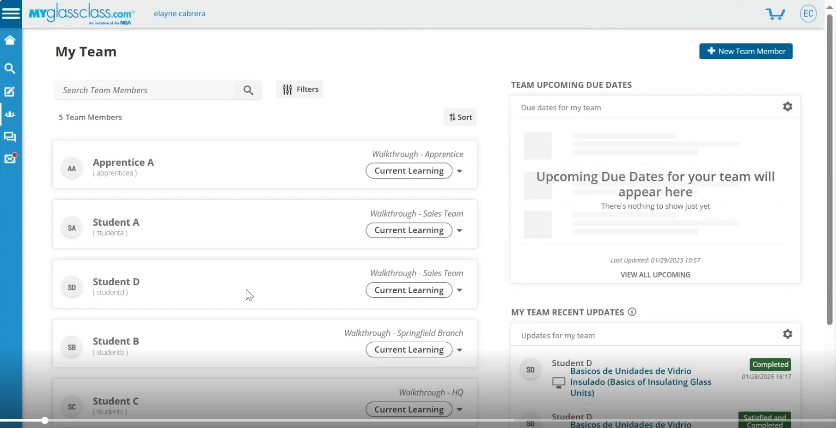
Enhanced Training Compliance
New Team Manager tool allows you to:
Track Employee Activity
Run Reports
Customize Training for Different Groups
Notes:
In addition to expanding our training content, NGA also moved MyGlassClass and MyGlassFAB training to a new Learning Management System that allows training supervisors to better monitor employee training compliance. The new system has a Team Manager function that allows supervisors to see what training courses employees are enrolled in; what courses they have completed; and their test scores.
Companies can customize their Team Manager to monitor training for individuals or employee groups. If, for example, you have a group of field personnel that needs storefront training under Bob’s supervision, and a group of shop personnel that needs fabrication training under Wendy’s supervision, you can create and manage two separate groups within the system. You can also run reports from the system to get an overall view of employee training progress.

Slide 9
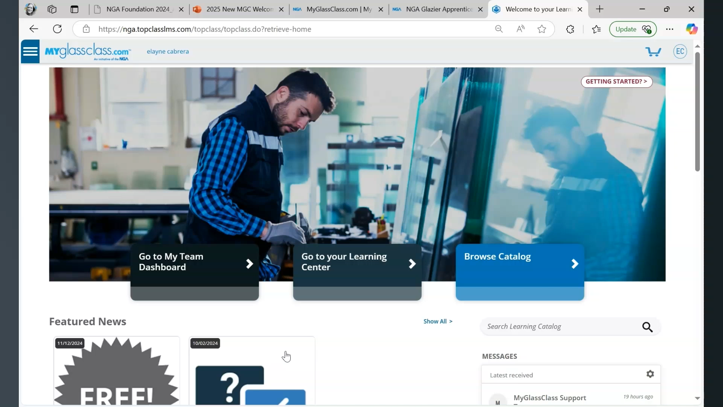
Notes:
NGA offers training on how to customize and best use the Team Manager function but here is a brief overview. ALICIA: PLEASE PLAY VIDEO

Slide 10
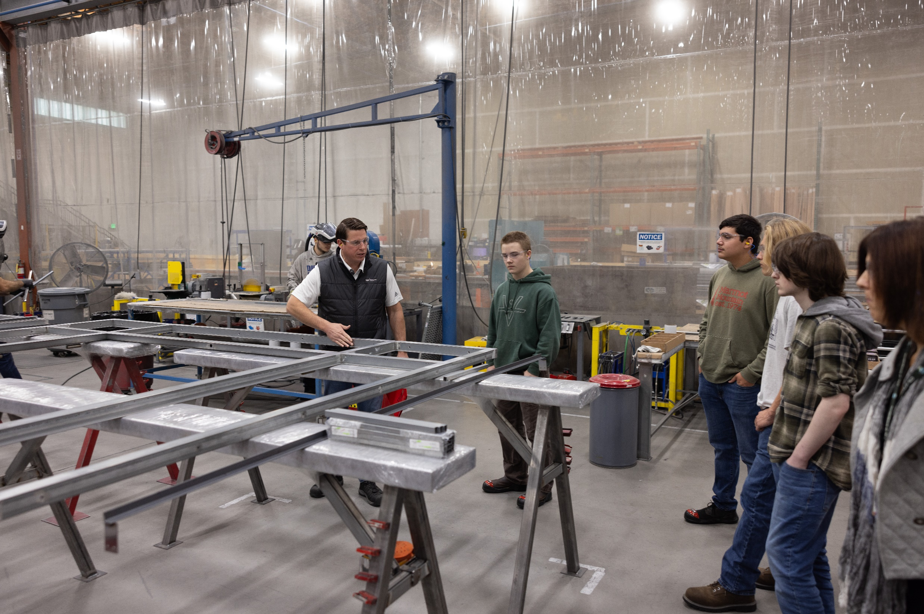
How to Build a Training Program
Ask yourself:
Who do I need to train?
How do I want to organize my program?
Who will lead our company training program?
Notes:
So how can you use these new tools to set up a company training program? Before you reach out to the MyGlassClass customer service team or begin enrolling employees, you should really think about what you want your program to look like. Who needs training? Is it new hires? Is it employees who are adding new skills? Maybe you have someone is a great at frameless shower enclosures but your company is getting into light commercial and they need storefront training. Who will lead this training effort? Does that person have the time and resources to be successful?

Slide 11
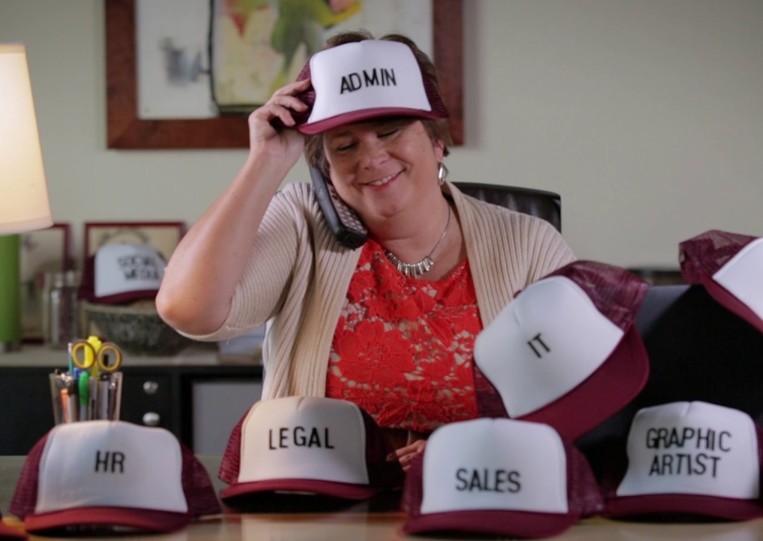
Don’t Ask Your Training Lead to Wear Too Many Hats!
Notes:
One mistake to avoid is handing development of a training program to someone who already has several other responsibilities. If you ask an employee who already has other jobs to also develop a training program, you may be setting them up for failure. Make sure you create time and space for your training lead to develop, oversee, and maintain your training program.

Slide 12
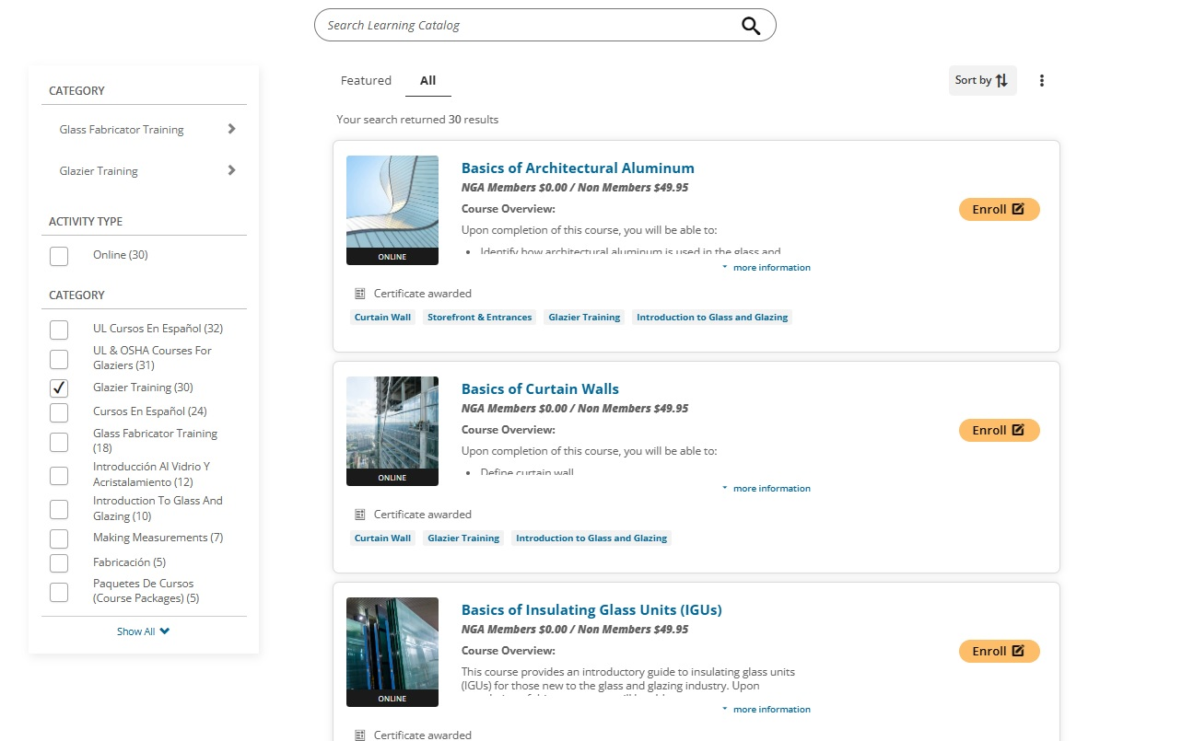
Do Your
Homework
What training courses do you want to offer?
Which employees do you want to train?
Notes:
Next step: Do your homework. Go through the MyGlassClass or MyGlassFAB course catalogs to select the training that is right for your employees. And when you’re doing so, make sure to choose a well-rounded course offering. On the installer side, for example, you might see glaziers who do storefront work day in and day out, and when they are asked to do a curtainwall project, they don’t have the right skills. You can use MyGlassClass and MyGlassFAB to expand your existing employees’ skillsets, in addition to training new hires.
Also think about how you want to organize your training. Do you want to have one group that includes all employees? A group for just new hires? A group for a specific location? Who will you appoint to lead those groups? These are all important questions to ask yourself.

Slide 13
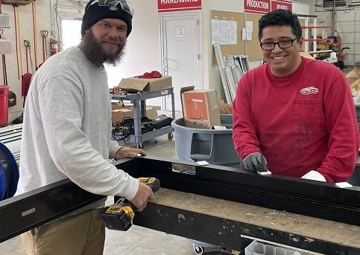
Decide What Program Format Works Best for Your Company
Internal LMS
Self-paced
Group training
Notes:
As I give these presentations, one of the questions I’ve been asked is how are companies implementing this training? I can tell you how I’ve seen it work at installing companies of various sizes. 1) Some companies have a Learning Management System, or LMS, in place where all of their HR resources already live. If your company has this type of system, we can actually provide you with the course files to load onto your LMS. This option is only available to NGA member companies. You can track employee progress, test scores, etc., from there rather than in the NGA system. There wouldn’t be a need to create employee accounts, etc. 2) You can tell employees which courses you want them to complete and pass the quizzes on, and give them a timeline for doing so. This is more of what I call a “self-paced” option because you are allowing employees to take the courses on their phones, on their own, and checking to make sure they’ve done so using your group admin access. Or 3) You can do group training maybe in a break room where you have a supervisor walk through a course with employees—adding their own experience and comments on the course material—and employees can follow along on their phones. If you go this route, we do recommend employees still have their own accounts with their own courses and quizzes, so you can make sure they are following along and actually paying attention and can see that they’ve passed the tests. Or you can do some combination of the above. I’ve heard of some companies using the courses during the hiring process as well to prescreen employees.

Slide 14
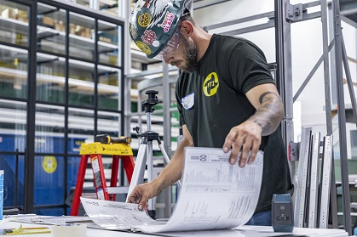
Train your Administrators
and Trainers
Notes:
Train your administrators and trainers! The NGA MyGlassClass Customer Care Team will train your supervisors or administrators—the employees who will be enrolling employees and using the Team Manager to track their progress—on how to use the new system, so we will take care of that.
But you also need to think about your hands-on trainers. While MyGlassClass and MyGlassFAB can get new employees up to speed faster and teach people best practices for new skills, they do not replace hands-on training. The best company training programs are those that combine MyGlassClass or MyGlassFAB with hands-on training. So, invest in the people you are asking to train your new hires, and reward them for their efforts.

Slide 15
Then (and only then)
Request Access to MyGlassClass.com
Email myglassclass@glass.org to
request group and team manager
access.
Schedule a Walk-Through of the LMS
Enroll Employees
Notes:
Then, and only then… And I say that jokingly (kind of), request access to MyGlassClass.com by emailing myglassclass@glass.org to request group and team manager access, and to schedule a walkthrough of the new system for your training administrators. Once your company is set up, you can ask employees to create their MyGlassClass accounts and enroll in the courses you have chosen for them.
Now, you do not *have* to use the Team Manager function. You can also just ask employees to enroll in the courses you’ve chosen for them, and they will be prompted to create an account. They can still share their activity reports with you on their own, if you’d prefer.

Slide 16
FREE
to NGA member companies
Visit The Hub www.glass.org/membership
Notes:
The best part is that all of this—the MyGlassClass courses for installers, the MyGlassFAB courses for glass fabrication personnel, the Team Manager access—is free to NGA member companies. So you can use the MyGlassClass platform to create your company training program at no cost. As a not-for-profit association, we want you to be able to access high-quality training—and all of our courses are developed by teams of industry experts. And we want to make it easier for you to train your employees.
If you are not an NGA member, I would encourage you to look at the Membership Hub on glass.org, where you can see what benefits NGA offers beyond the free MyGlassClass and MyGlassFAB courses. And you can also do a cost analysis. You can look at the member dues, training costs for non-members, and make the decision that makes the most sense for your company.

Slide 17
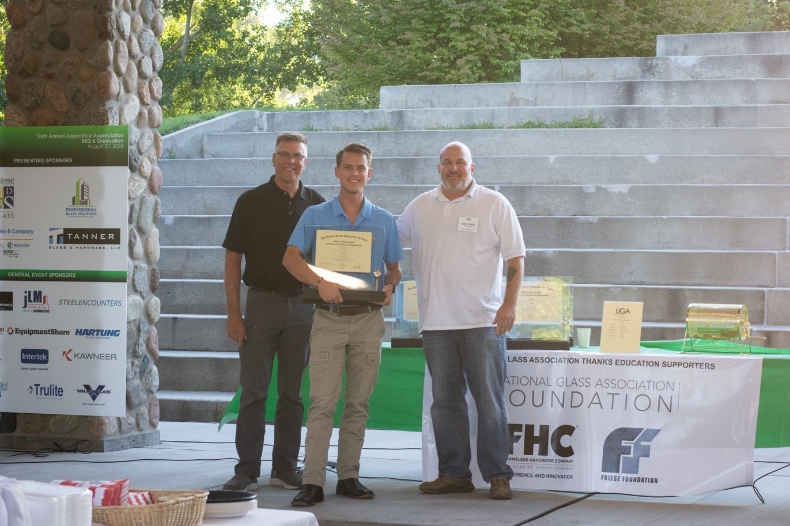
Last, but not least…
Recognize and reward employees who participate and excel in training
Notes:
And last but not least, I would encourage you to recognize and reward employees who participate and excel in training programs. Consider incentivizing employees to participate in online and hands-on training and reward those who do w/lunches, leaving early on a Friday, opportunities to advance on the payscale, whatever makes sense for your company. It shows that you not only value their education, but that you recognize their efforts, which can help in employee retention.

Slide 18
Questions?
Jenni Chase
NGA VP, Workforce Development
Elayne Cabrera
NGA LMS Manager for
Workforce Development
Notes:
So that was a lot of talking! Thank you for sitting through this presentation. I think we have a few minutes for Q&A, so Alicia, if you want to look at the chat, Elayne and I can answer a few questions.

Slide 19
How to Build a Training Program Using the New
NGA UPCOMING EVENTS
NGA Glass Conference: Carlsbad
Feb 3-6, 2025
BEC Conference
March 2-4, 2025
Notes:
Thank you for attending. A reminder, a recording of this webinar will be added to glass.org/webinars by the end of this week, and the MyGlassClass Customer Service team is available at myglassclass@glass.org to answer additional questions. We will also post a checklist of the items covered in this session alongside the webinar recording for easy reference.
Have a great afternoon!

